Slide 1

Operating Systems
BCSC 0004
CPU Scheduling
Shortest Remaining Time First
(SRTF)

Slide 2
Shortest Remaining Time First
Shortest remaining time First (SRTF) is the preemptive version of the SJF algorithm.
The processor is allocated to the job closest to completion but it can be preempted by a newer ready job with shorter time to completion.
Impossible to implement in interactive systems where required CPU time is not known.
It is often used in batch environments where short jobs need to give preference

Slide 3
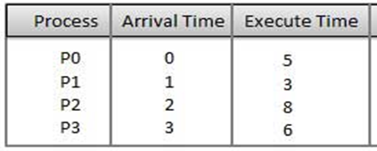
P0
P1
P0
P3
P2
0
1
4
8
14
22
Average waiting time = ((3-0)+(1-1)+(14-2)+(8-3)) / 4 =22/4= 5.5

Slide 4
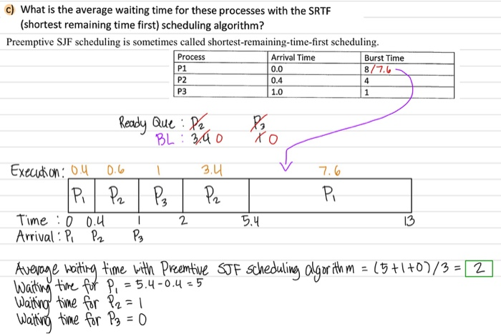
SRTF

Slide 5
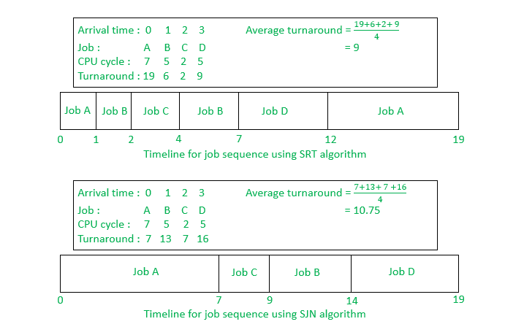

Slide 6
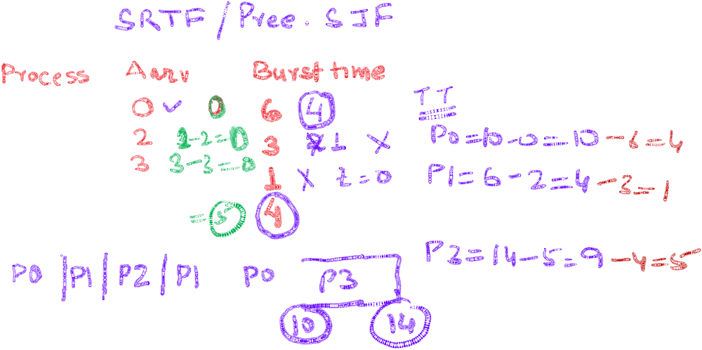
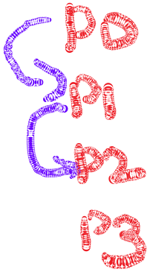


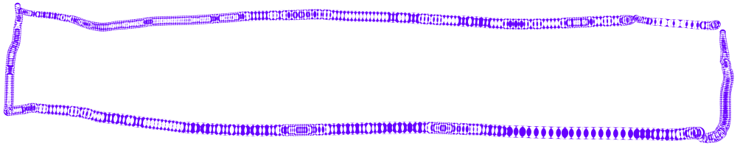
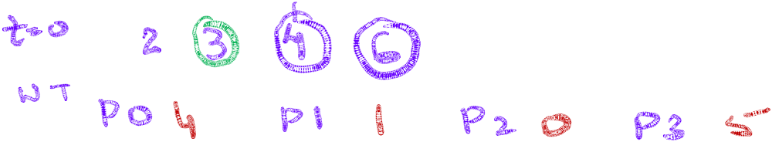

Slide 7
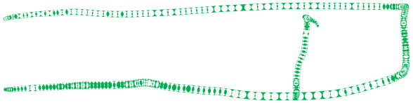
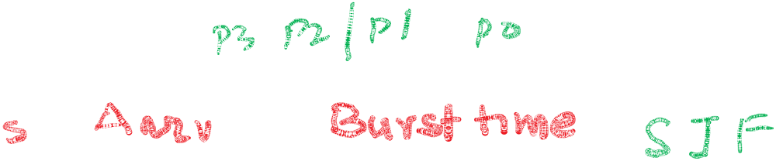




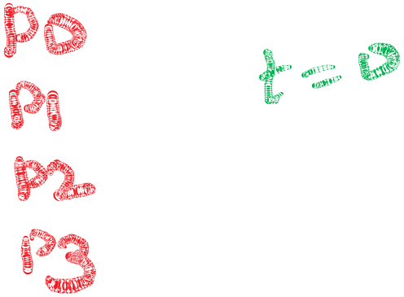


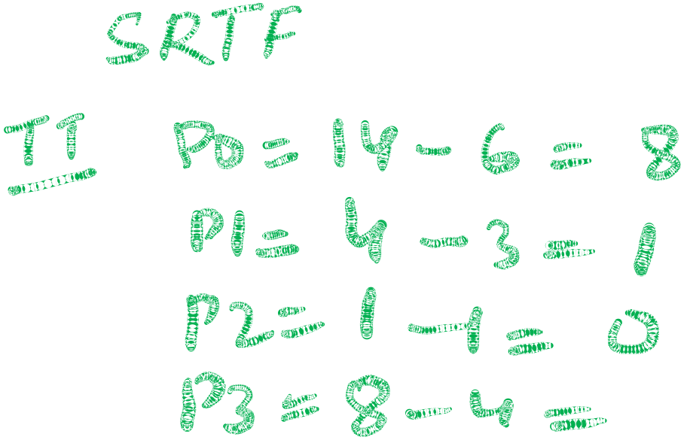








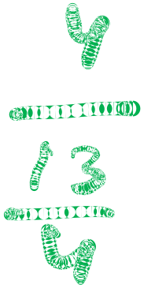
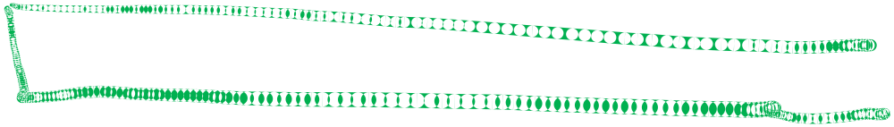

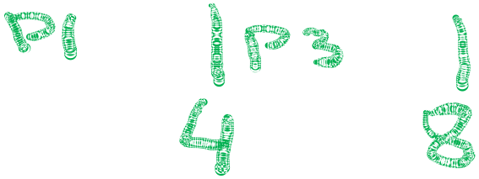
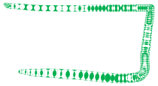





Slide 8


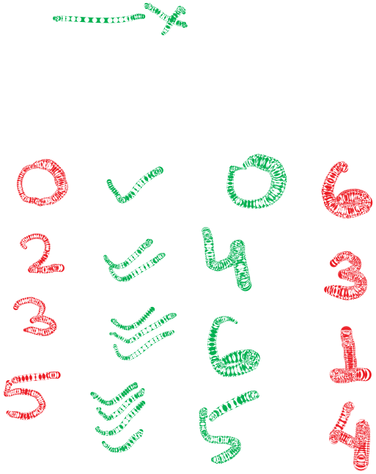









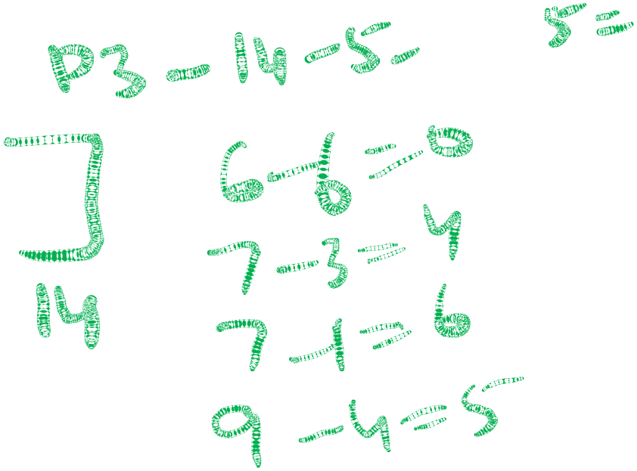


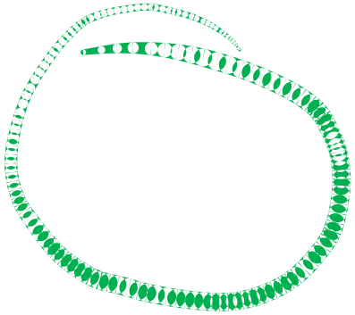









Slide 9


